Slide 1

Solving Neurodevelopmental Disorders
James Lawlor
Computational Biologist: Greg Cooper Lab
Biotrain Bootcamp
May 29-30, 2024

Slide 2



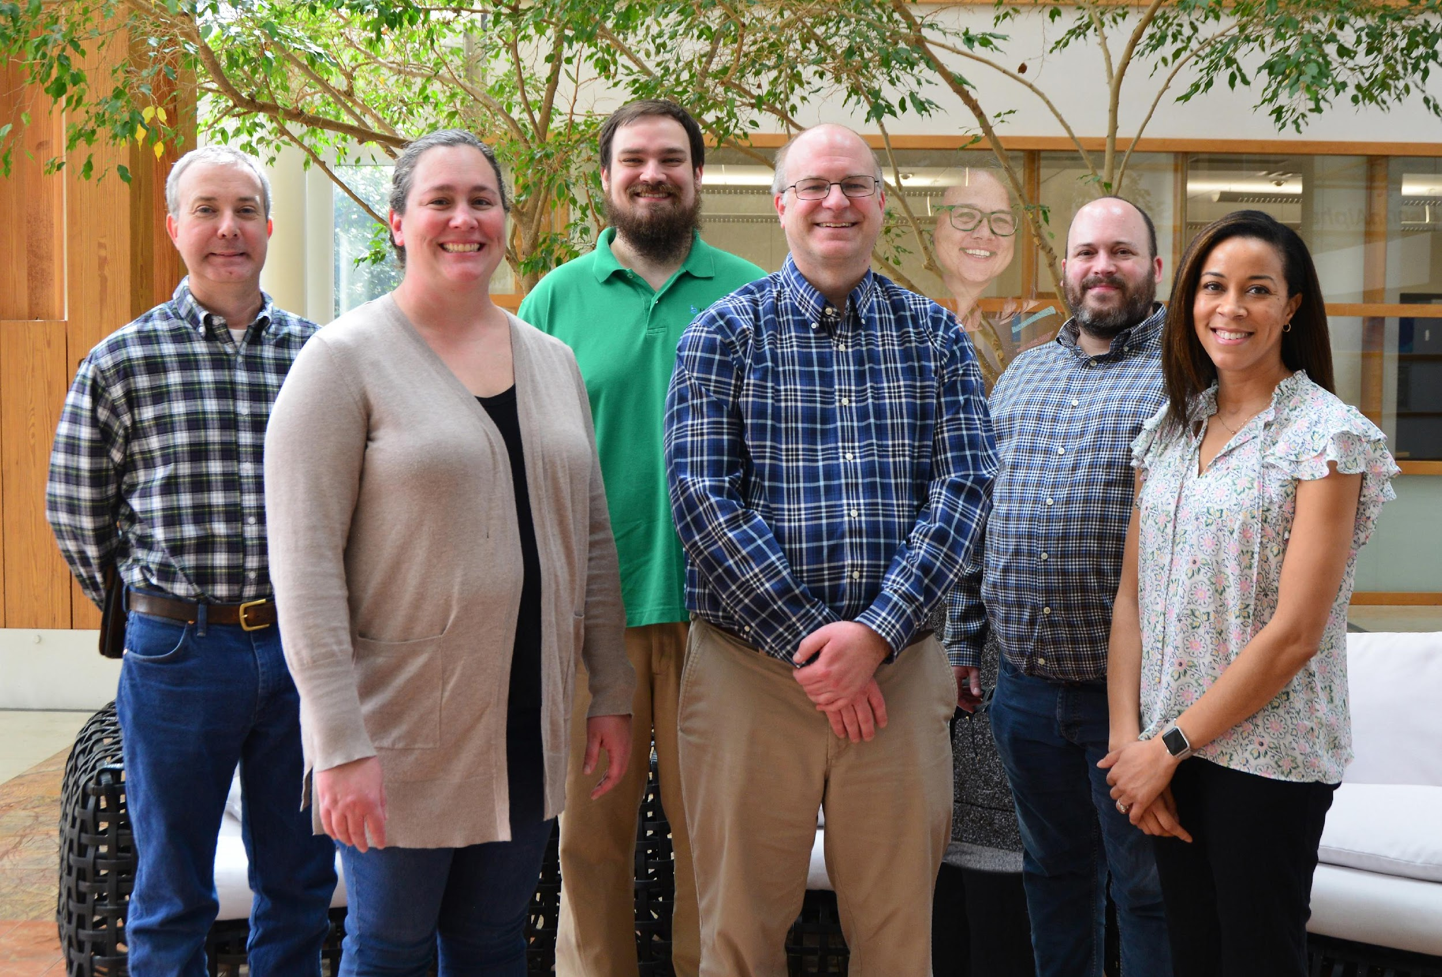

Greg Cooper Lab
Goal:
Identify genetic causes of neurodevelopmental diseases

Slide 3
Me
Background: Maryland -> Guntersville -> Huntsville
Undergrad:
Snead State CC (Boaz, AL): A.S. – Chemistry (2006-2008)
UAH:
B.S. Chemistry (ACS Biochemistry Track) & Mathematics (2008-2011)
grad classes + tutoring (2012)
Bonus: UAH Concert & Chamber Choir: 2008-2012
M.S Modeling & Simulation (CS dept): 2014-2017
Thesis: Using machine learning models to predict enhancers of CFTR

Slide 4
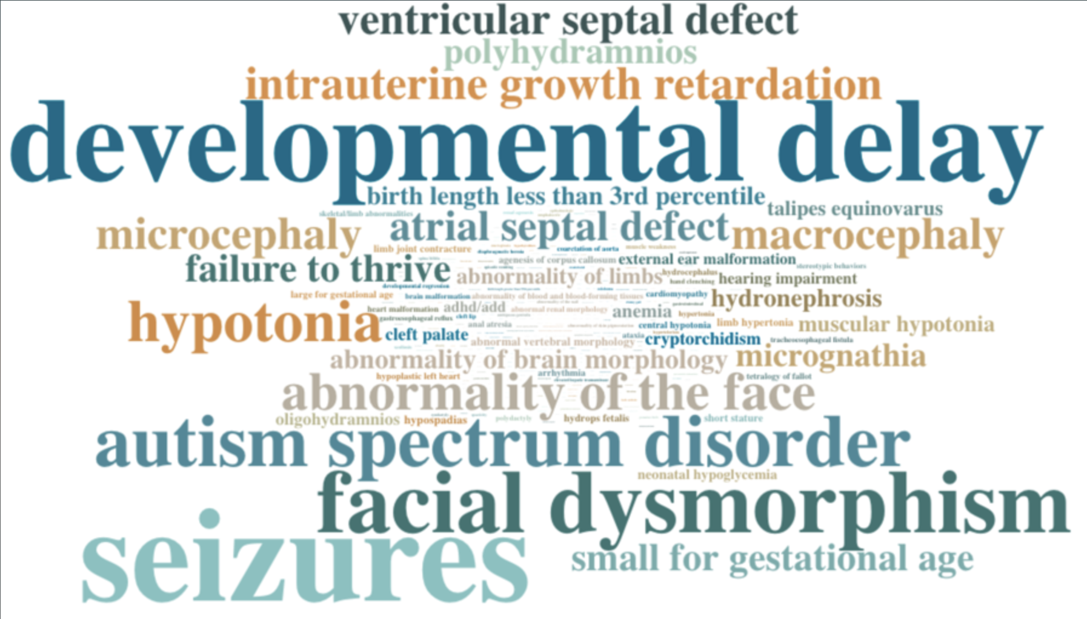
Neurodevelopmental Disorders (NDD)s
Seizures
Developmental Delay
Intellectual Disability
Motor Disorders
Limb and Facial Differences

Slide 5
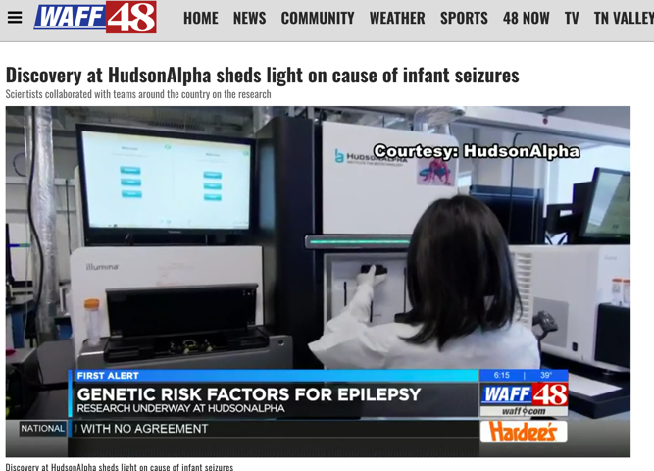

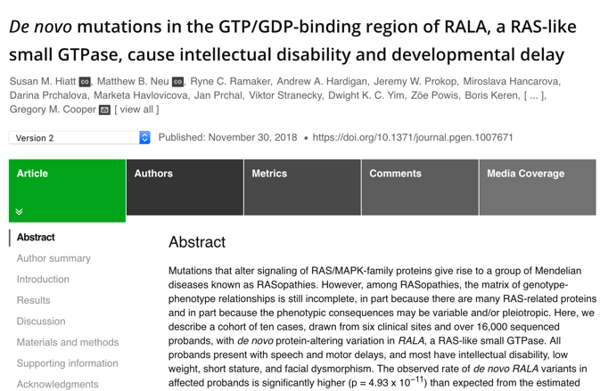
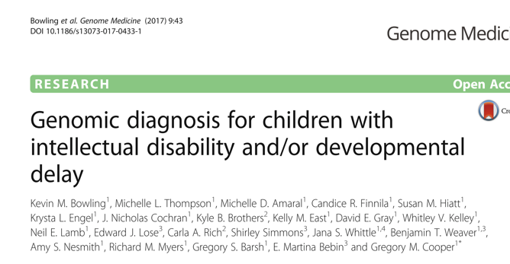
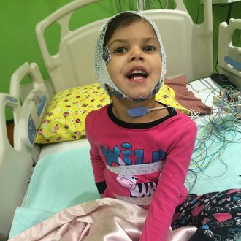

Why?
Genomic Diagnoses can:
End family’s “diagnostic Odyssey”
Increase access to services
Inform treatments
Link disease (symptoms) to specific gene(s)
First step to learn disease biology

Slide 6
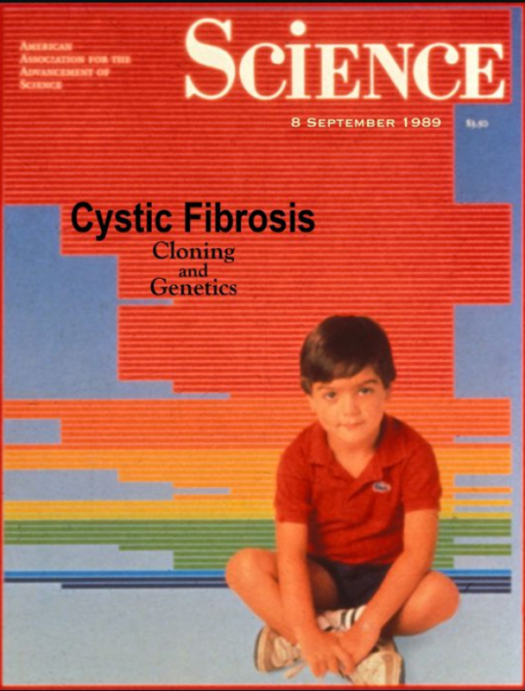
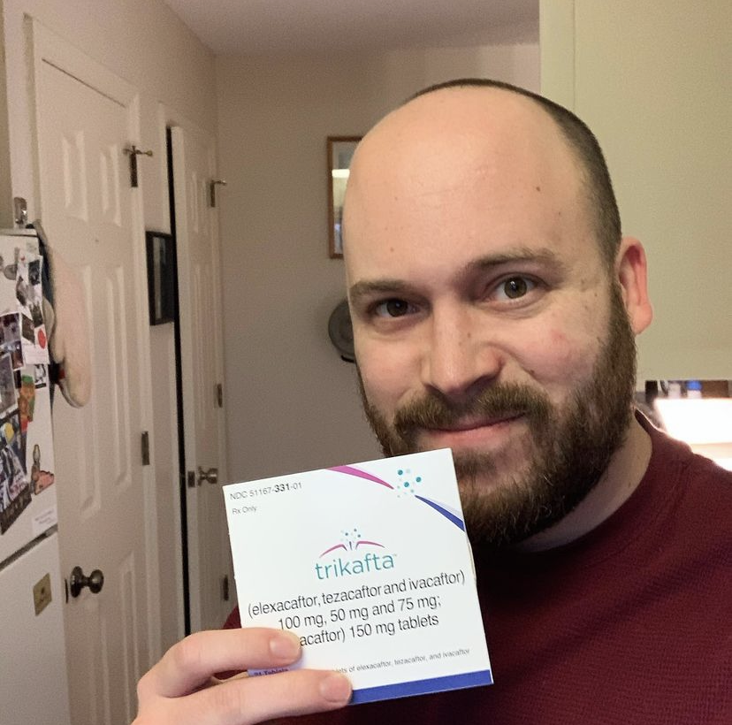
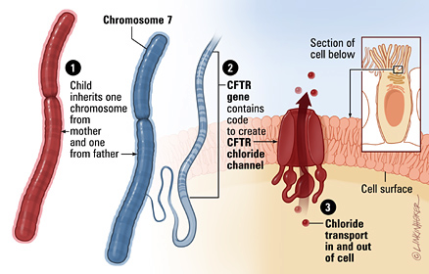
Disease-gene relationships are critical to scientific advancement & treatment
1989
1990s-2000s
2019
Notes:
But first I want to pause and reiterate why this basic science that does the work of linking new diseases to genes is so important. In my own life as a CF patient, I’ve been able to witness the direct impact of knowing precisely how a congential disease is affecting the patients on a genetic and molecular level. CFTR, the causative gene for Cystic Fibrosis, was found in 1989, and we eventually learned that it encodes a chloride channel whose malfunction causes the thick mucus that is the hallmark of this disease. This understanding has been critical to a majority of the treatments that I use every day. And that’s why

Slide 7
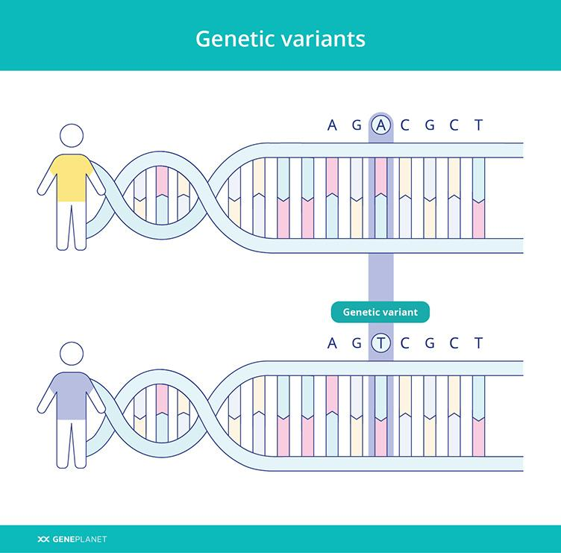

Slide 8
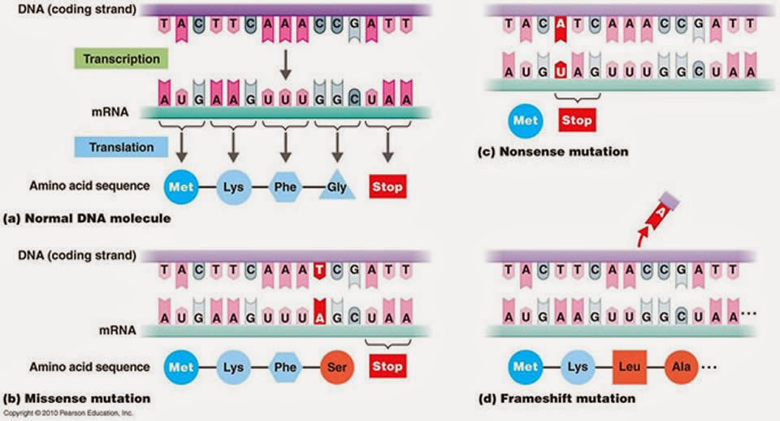
Best-understood variants alter proteins

Slide 9
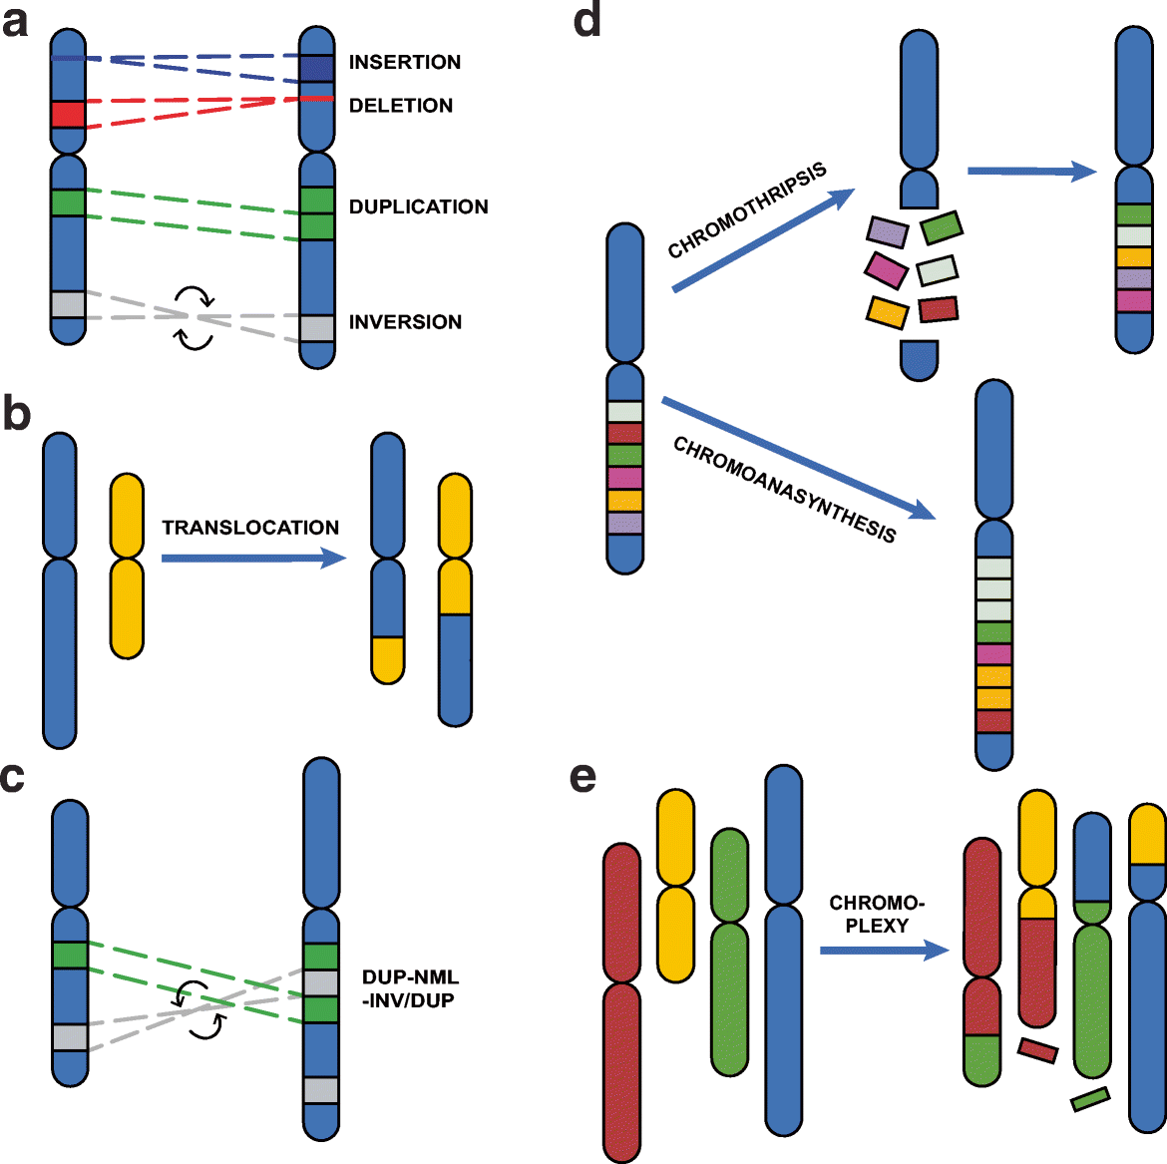
Structural Variants Cause Many NDDs
Balachandran, P., Beck, C.R. (2020)

Slide 10
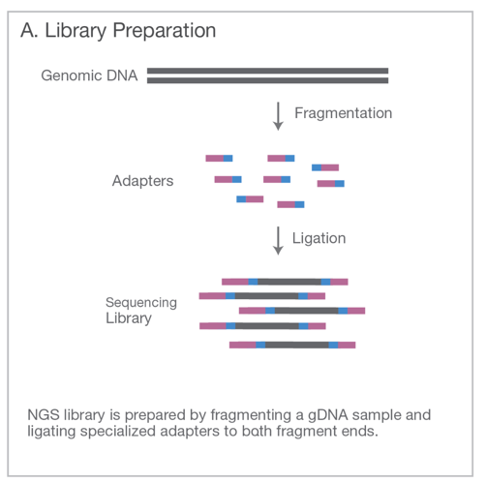
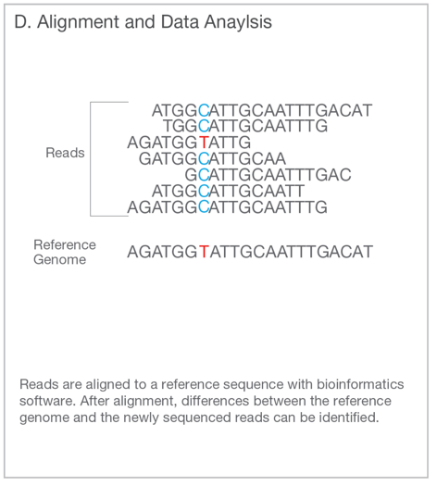
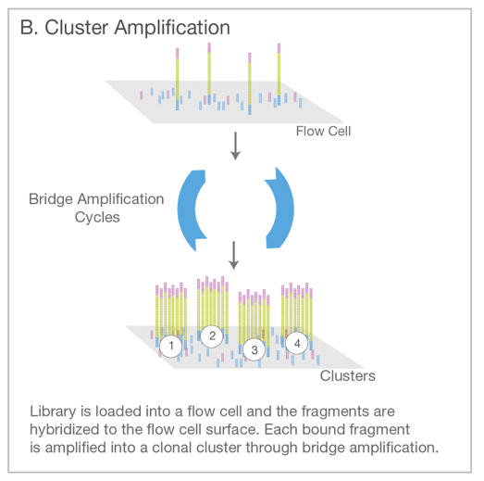
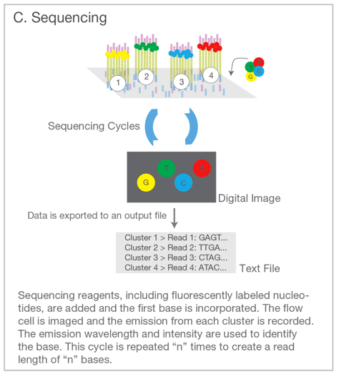
Genome Sequencing (Short Read / Illumina)
Illumina. An introduction to Next-Generation Sequencing. (2017).

Slide 11
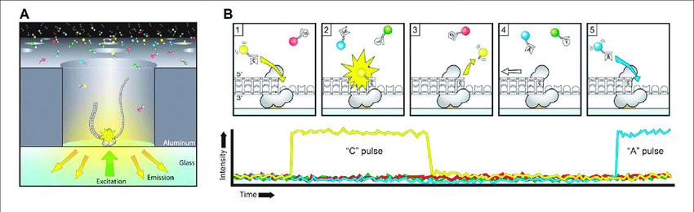
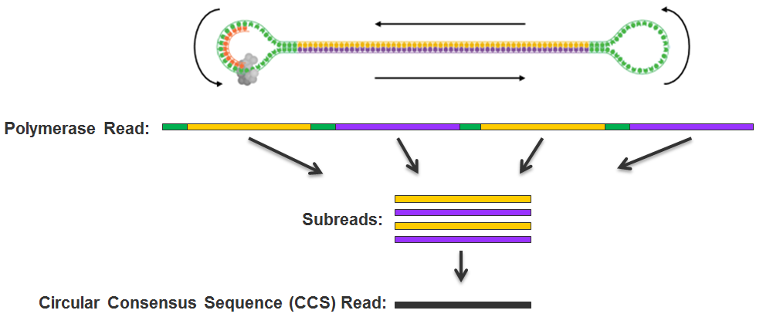
Long Read / PacBio

Slide 12
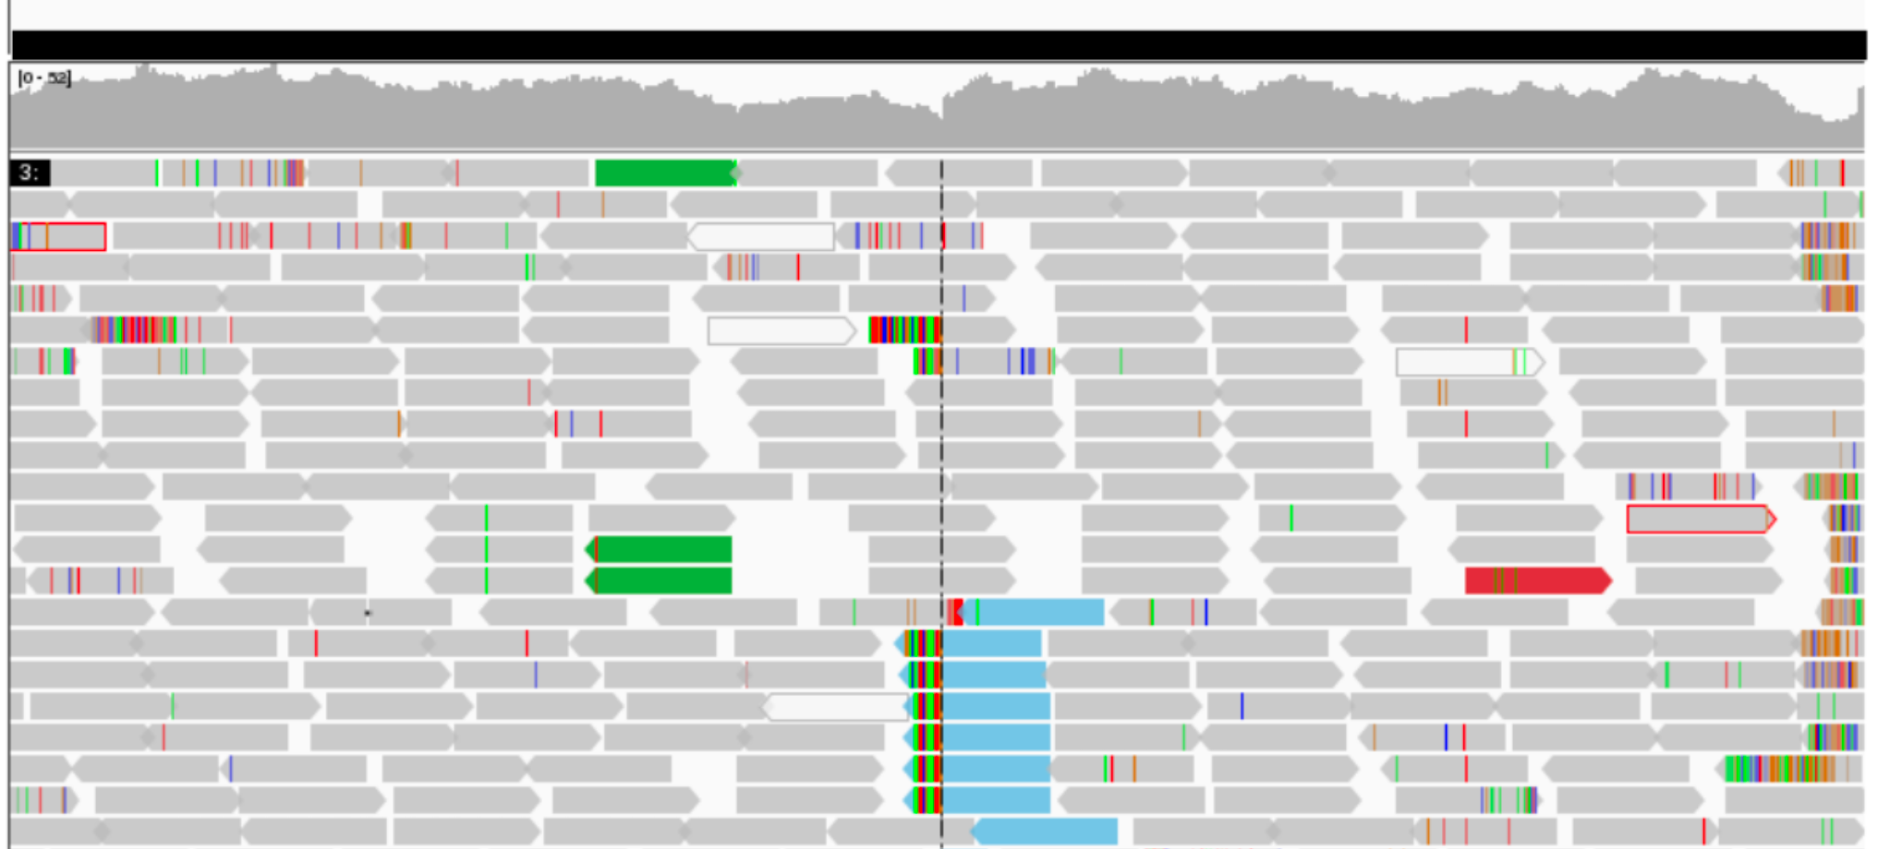
“Variant Calling” or “Genotyping”: Data -> Description
Align reads to reference genome
Find a pattern in suspicious reads
Sequence
Depth
Pairing
Calculate statistical likelihood
12

Slide 13
Filtering / Analysis / Interpretation is key
population frequency
genomic annotations
computational predictions
inheritance pattern
clinical disease databases
phenotypes
published literature
~4,000,000 variants
~1 causal variant
We evaluate the totality of existing evidence for a particular variant

Slide 14

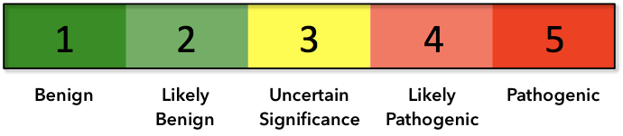
Assess Evidence
Population Frequency
Inheritance
Computational Evidence
Patient’s Phenotype
Variant Type
Previously Reported
Functional Assays
Clustering in a functional domain

Slide 15
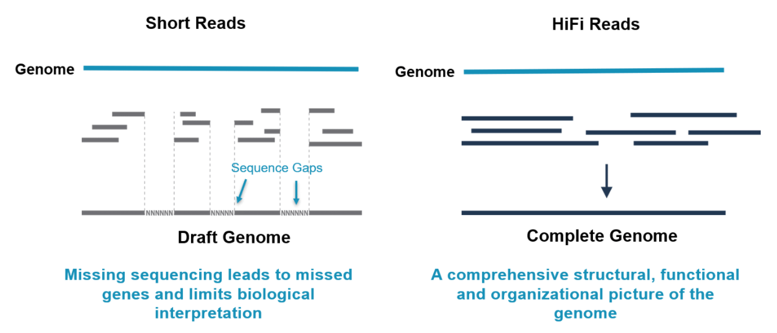

Benefits of Long-Read sequencing
(150 bp)
(10,000-20,000 bp)
Longer reads 🡪 better alignment to the genome 🡪 more accurate variant calling

Slide 16
Long Read SV Examples

Slide 17
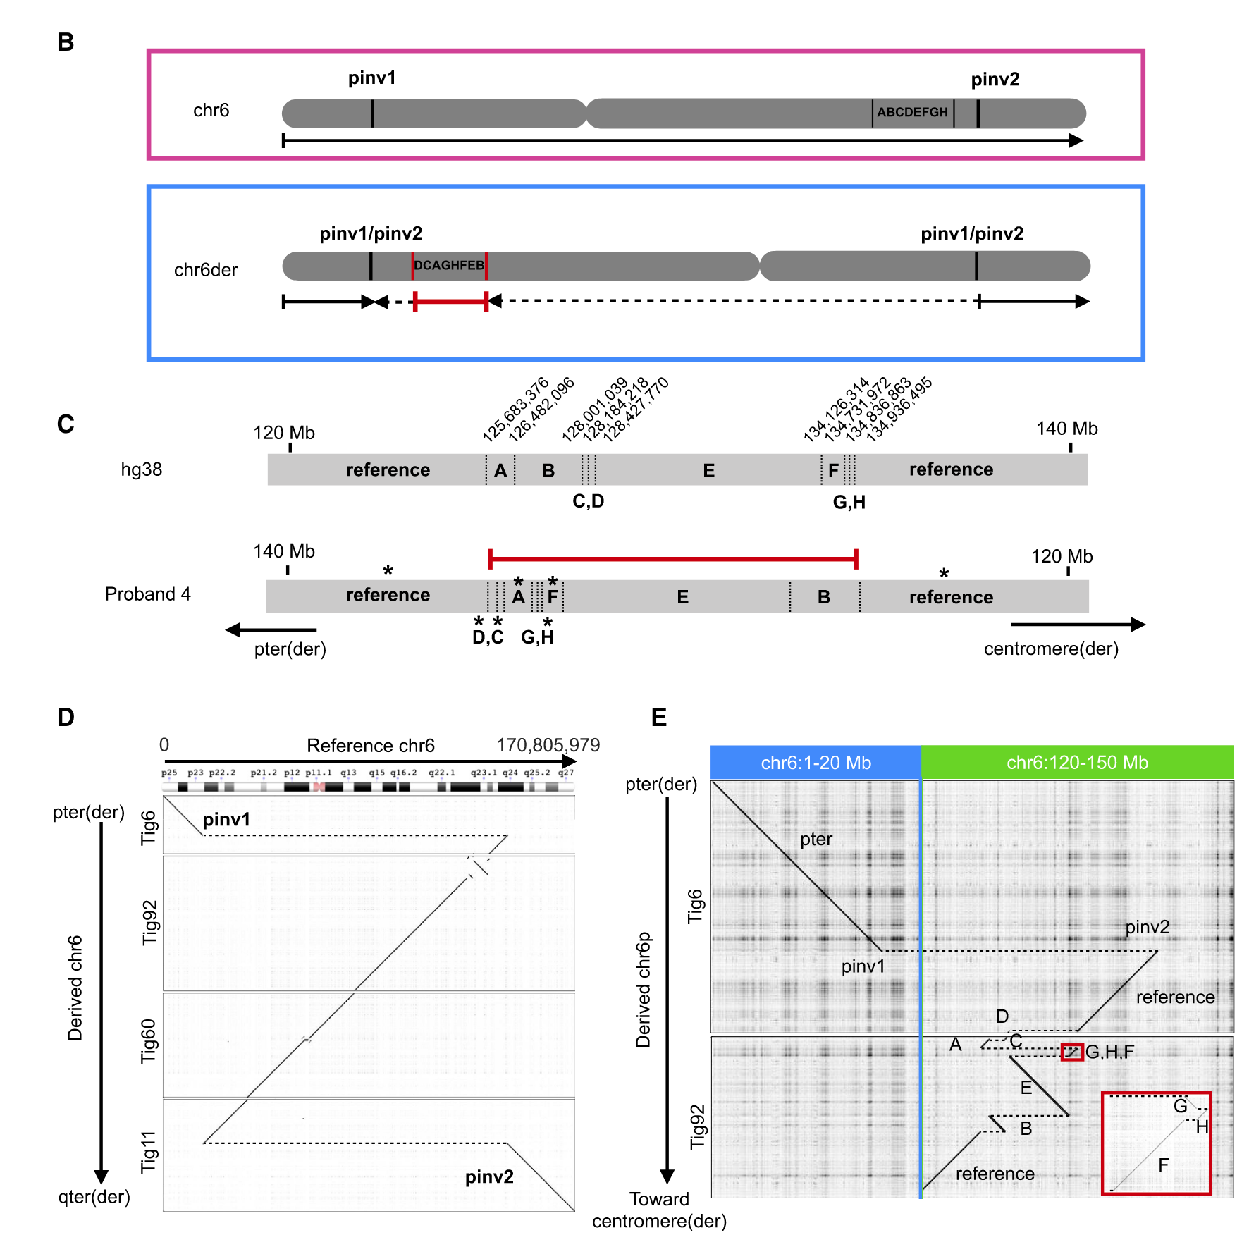
Hiatt (2021)

Slide 18
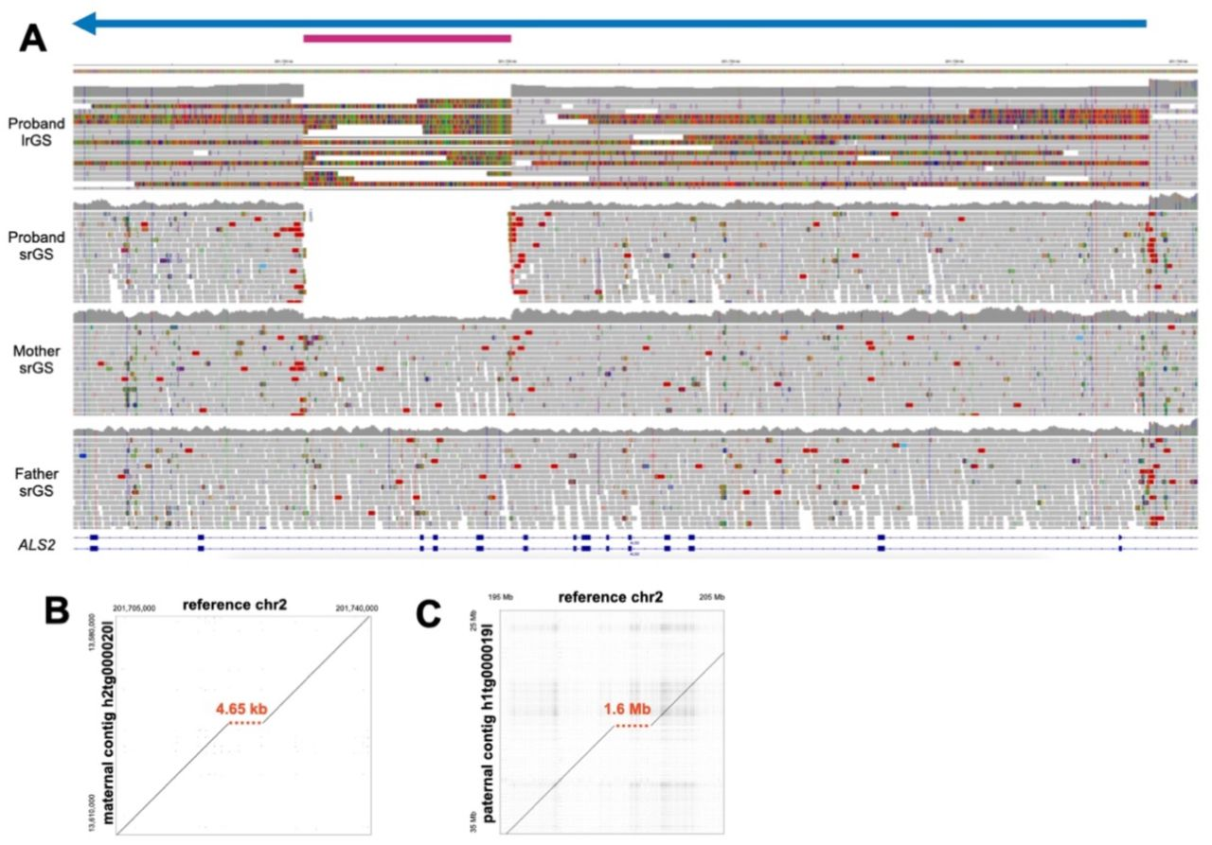
Hiatt (2023)

Slide 19
My Role

Slide 20
Computational Biology / Bioinformatics
Use computational tools
Programming
Mathematical models & machine learning
Databases
Physics simulations
To analyze huge sets of data
Genome sequencing
Protein modeling
And answer biological questions
How does this gene work?
Does this disease have a genetic pattern?
How are these species related?
What makes a liver cell different from a brain cell?

Slide 21


Slide 22

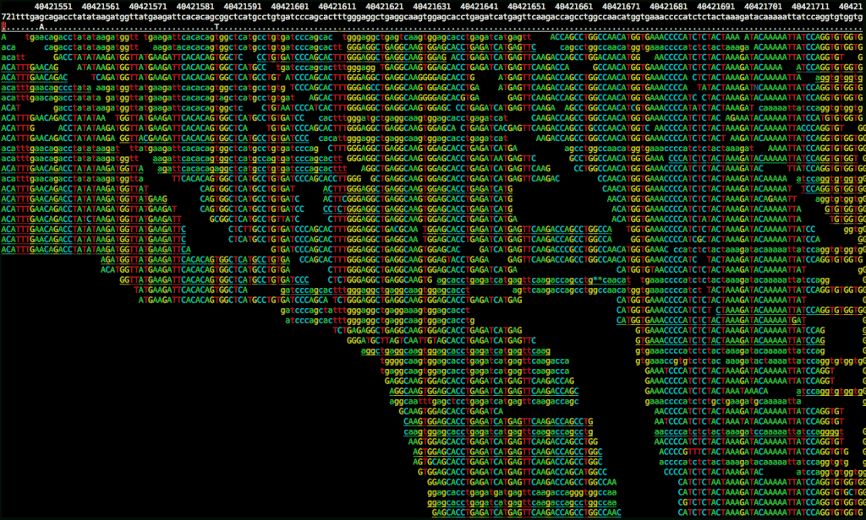

Picturing the Whole Process
22

Slide 23
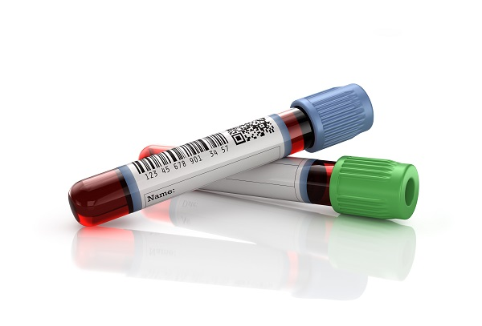
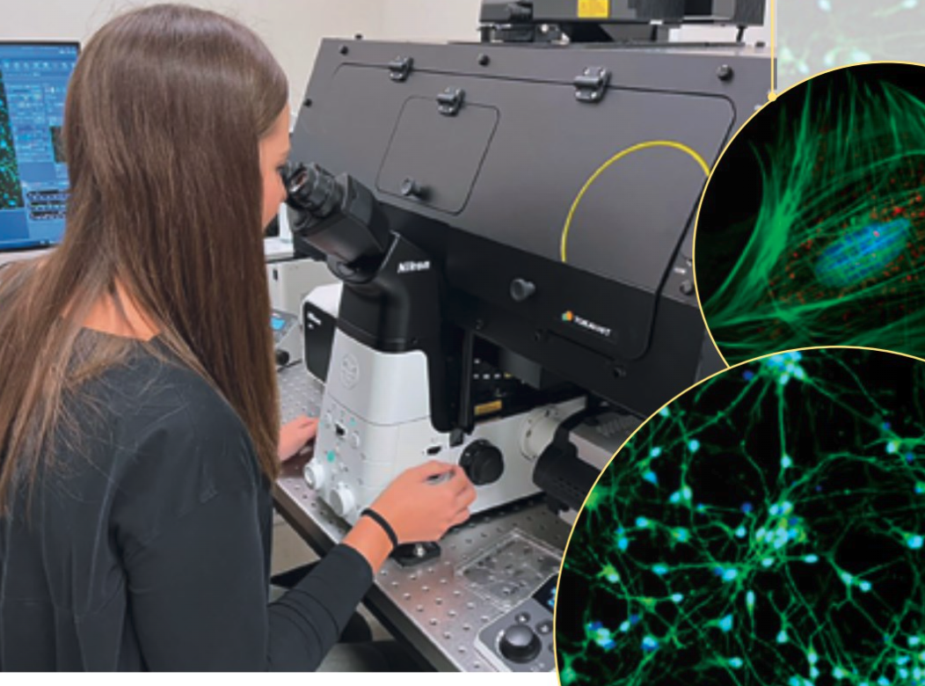
Sequencing
Variants
Ref & SW
Technology
QC + Accuracy
Sample
Type
ID codes
Conc.
Results
Patient
Symptoms
Diagnoses
Prior test results
Science
Ref Genome
Disease <-> Gene
Population variants
Func. predictions
Physician
Questions
Orders

Slide 24
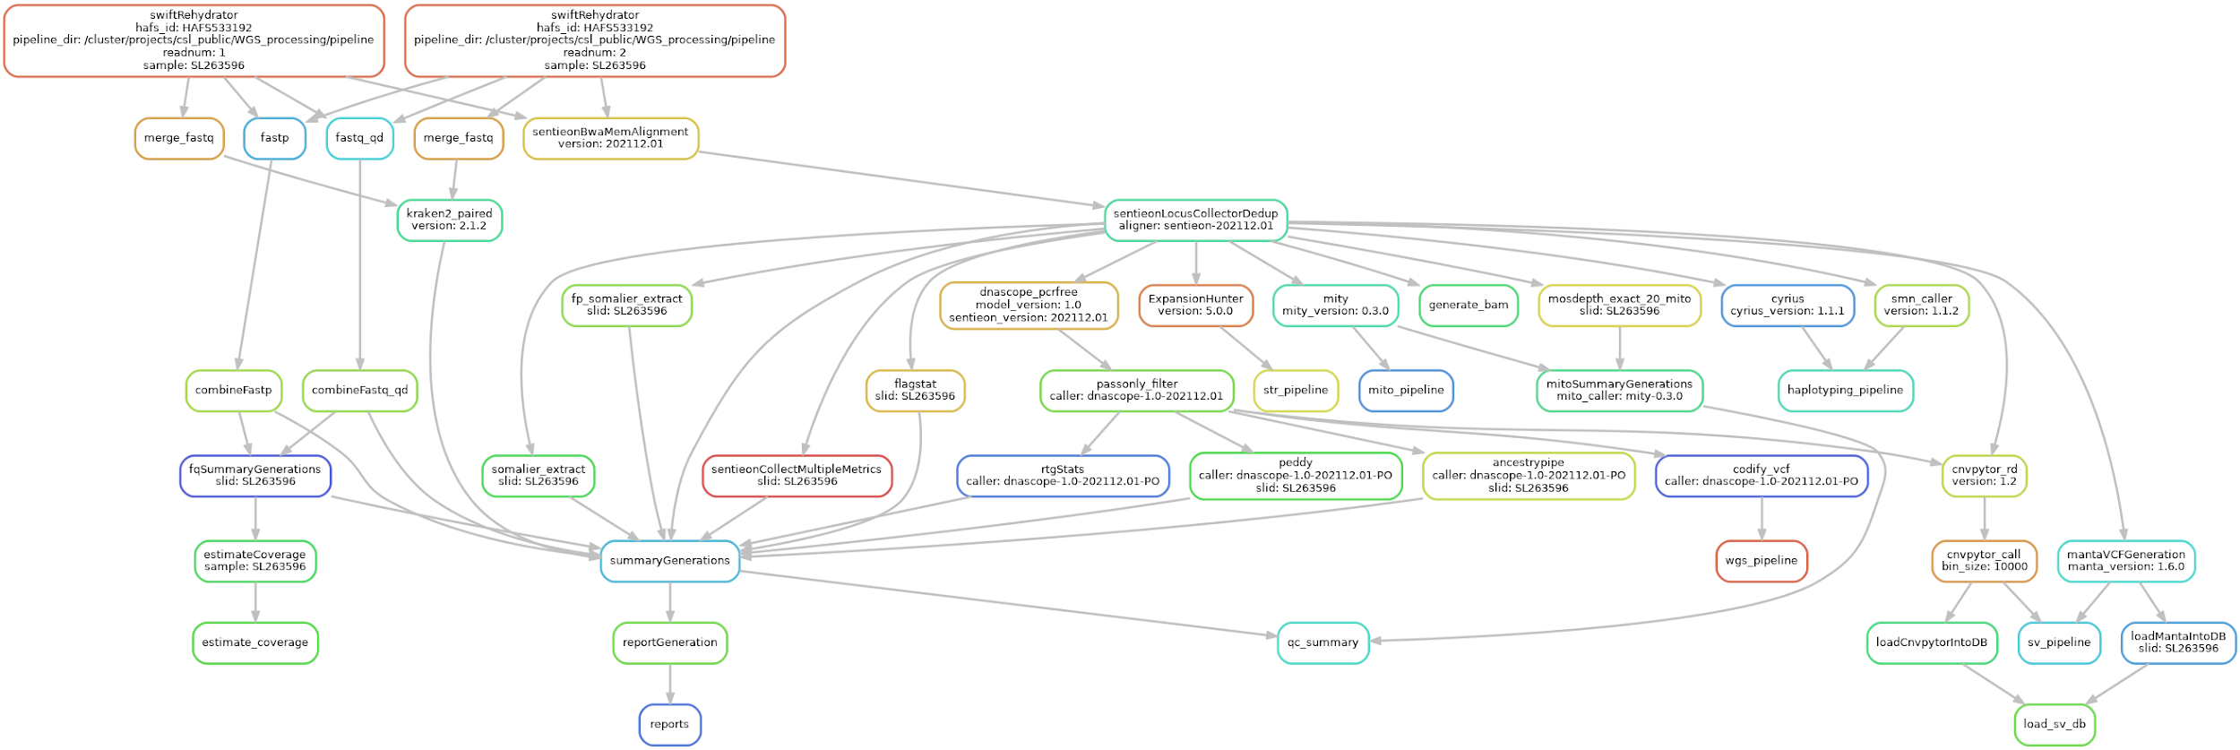
WGS Computational Workflow

Slide 25
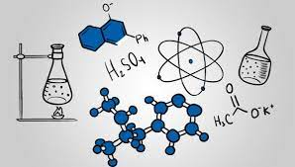



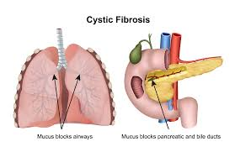


My Trajectory
High School
Web & SQL
Difficult -> felt boring
BS: Biochemistry & Math
Job: Tutoring & Higher Ed.
Job: Missile Defense Cost Analyst
MS: Modeling & Simulation
Project: Cystic Fibrosis Genomics + Machine Learning
HudsonAlpha Computational Biologist
Programming as a tool to solve interesting scientific problems

Slide 26
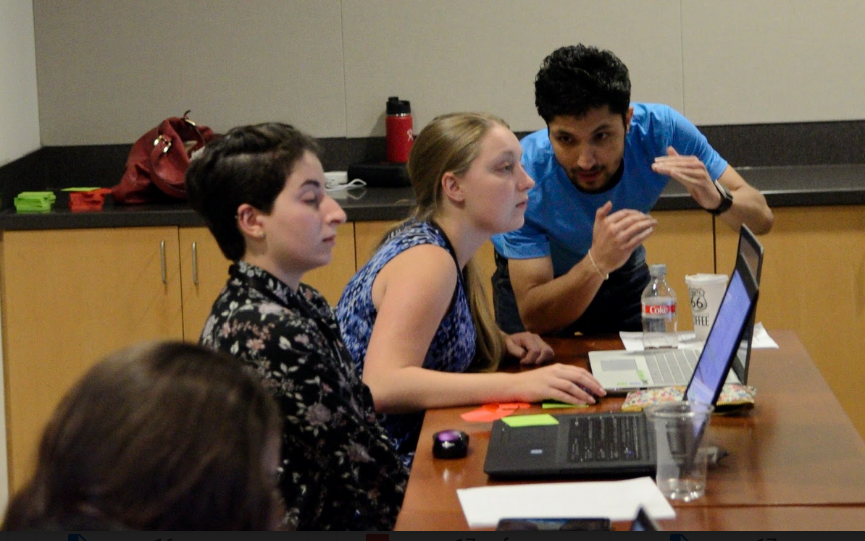
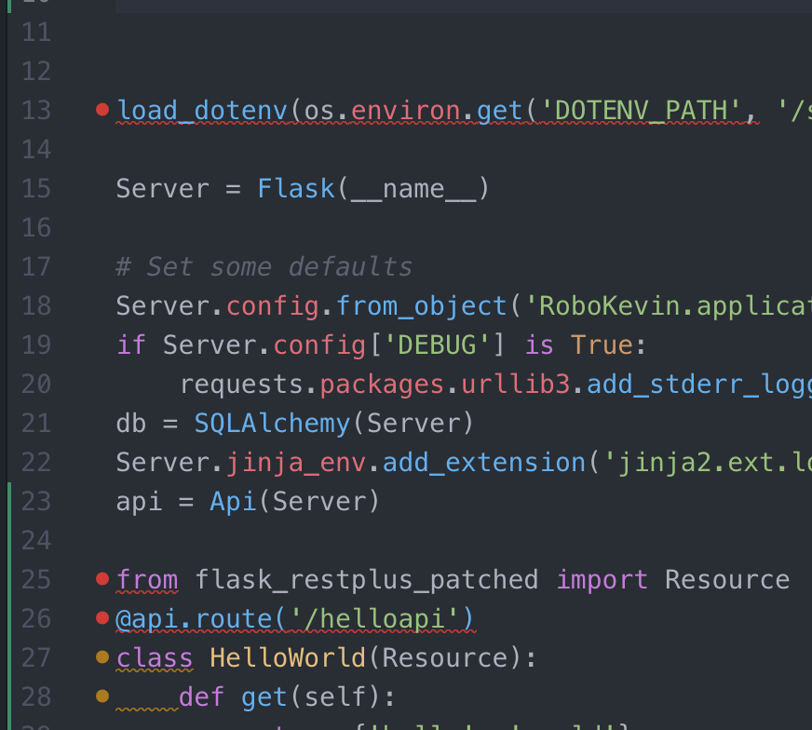

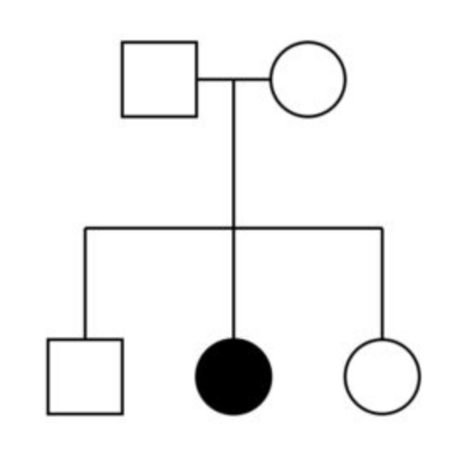
Critical Skills
Communication
Tech writing
Public speaking
Teamwork
"Translating"
Business Process
Automation
Documentation
Data management
Science
Genetics & Biochemistry
Statistics
Scientific Literature
Tech
Programming
Compute clusters
Unix
Troubleshooting
New languages & tools

Slide 27
Summary
Genomic diagnoses benefit families with NDDs
Long-read sequencing can help identify more structural variants causing NDD
Computational expertise needed at many points in the process

